Slide 1





FRONTEND TECHSTACK
Luja Shakya
Nirjal Prajapati

Slide 2
WHAT YOU SEE
WHAT YOU CAN DO
HOW IT REACTS

Slide 3
FRONTEND
Front-end web development, or client-side development, refers to working with HTML, CSS and JavaScript for a website or web application that allows users to see and interact with them directly

Slide 4

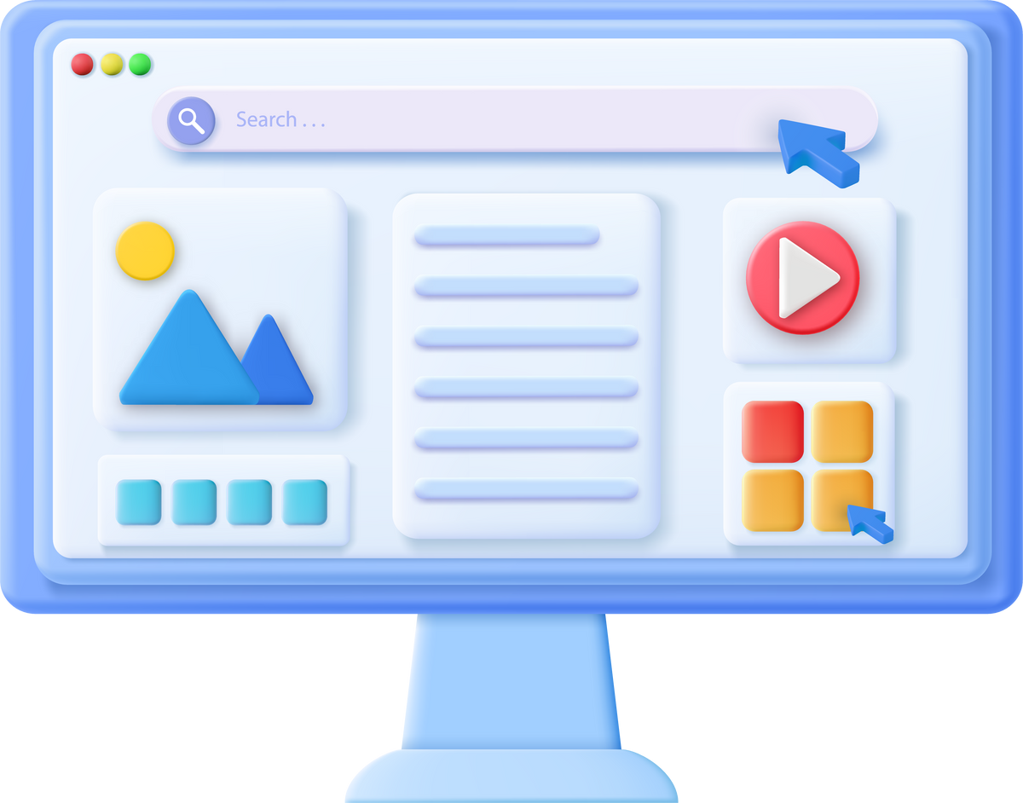
FUNDAMENTALS
01 - HTML
02 - CSS
03 - JAVA SCRIPT

Slide 5
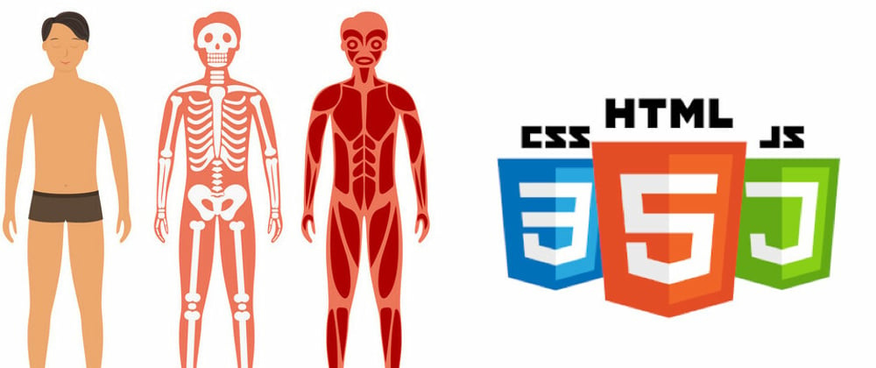
FUNDAMENTALS
01 - HTML
STRUCTURE
Analogy as
skeletal system in a
human body
02 - CSS
Tag out of Place can
break whole system
03 - JAVA SCRIPT

Slide 6
FUNDAMENTALS
01 - HTML
APPEARANCE
Analogy as
Outer looks of an interactive system
02 - CSS
Way it represents
info and data
03 - JAVA SCRIPT

Slide 7
FUNDAMENTALS
01 - HTML
BEHAVIOUR OR ACTION
Analogy as
Nervous system in a
human body
02 - CSS
Handles behaviours
and actions to event
03 - JAVA SCRIPT

Slide 8
DEEP DIVE
-HTML-

Slide 9
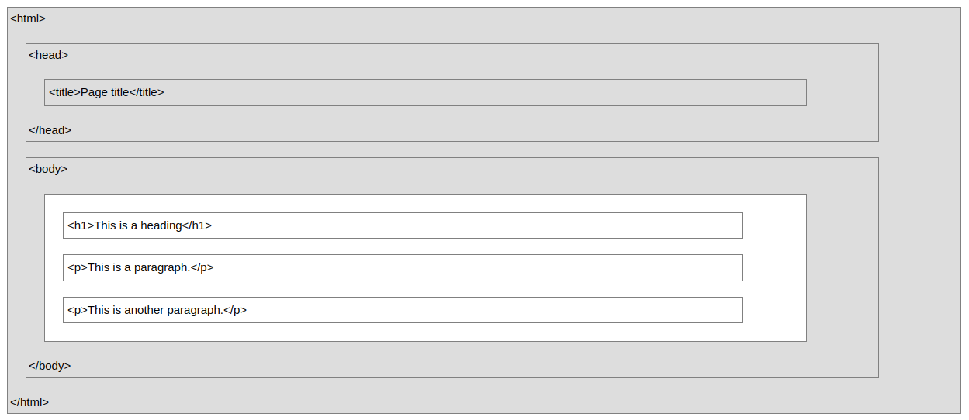
HTML SYNTAX
TAGS
ATTRIBUTES
<html> , <head>, <body>, <h1> , <p> , <table> ...
id , class , style , width , height , data-*

Slide 10

DOM (DOCUMENT OBJECT MODEL)
HTML elements as objects
Properties for all HTML elements
Methods for all HTML elements
Events for all HTML elements
PS :We will see details in Demo

Slide 11
DEEP DIVE
-CSS-

Slide 12
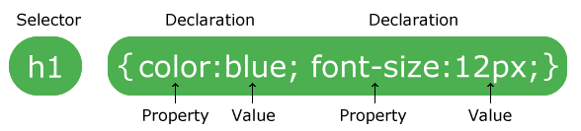
CSS SYNTAX
CASCADING STYLE SHEETS
TYPES
EXTERNAL CSS :
HAS EXTERNAL FILE FOR CSS THAT LINKS WITH HTML
INTERNAL CSS :
HAS <STYLE> TAG BOUNDS FOR CSS INSIDE HTML FILE
INLINE CSS :
ATTRIBUTE STYLE INSIDE CORRESPONDING TAG

Slide 13
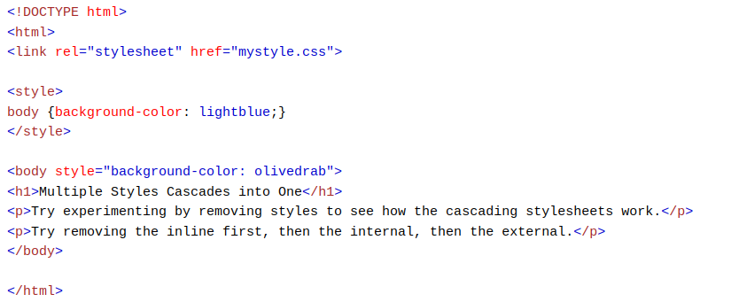
USAGE EXAMPLE
EXTERNAL CSS :
INTERNAL CSS :
INLINE CSS :
PS :We will see details in Demo

Slide 14
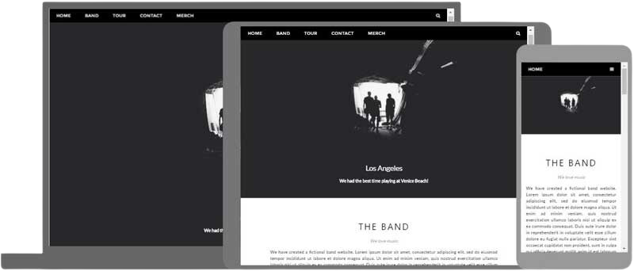
res
RESPONSIVE WEB DESIGN
Resizing or changing layout / elements according to screen size
Media Query
@media screen and (max-width:800px) {
<responsive css here >
}

Slide 15
res
RESPONSIVE WEB DESIGN
Popular Libraries and Frameworks for Designing in Smart ways
Bootstrap : Powerful, feature-packed frontend toolkit
Tailwind CSS :
A utility-first CSS framework packed with classes
MUI :
A UI framework that provides a set of pre-designed components and utility classes based on Google’s Material Design guidelines.
Bulma :
A modern CSS framework that uses Flexbox to create responsive layouts.
...

Slide 16
DEEP DIVE
-JS-

Slide 17
JS FUNDAMENTALS
JavaScript variables can be:
Numbers
Strings
Objects
Arrays
Functions
Function can be called and invoked as events to do certain behaviours .
PS :We will see details in Demo

Slide 18
DOCUMENT SELECTORS
The HTML DOM is an API (Programming Interface) for JavaScript:
JavaScript can add/change/remove HTML elements
JavaScript can add/change/remove HTML attributes
JavaScript can add/change/remove CSS styles
JavaScript can react to HTML events
JavaScript can add/change/remove HTML events

Slide 19
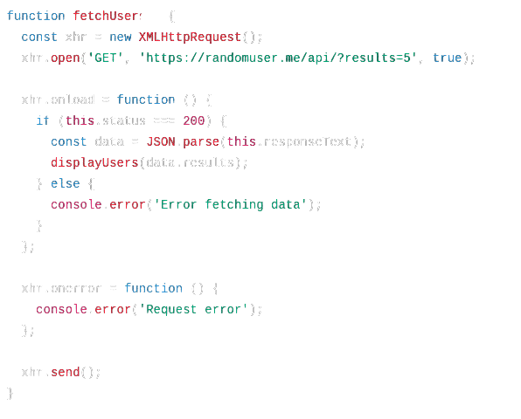
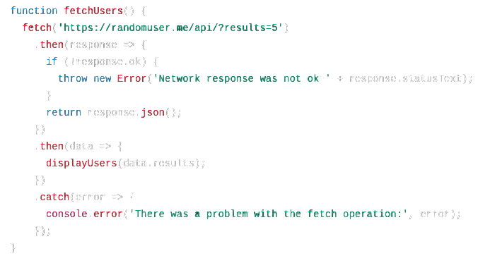
API CONNECTION
XHR CONNECTION REQUEST
FETCH REQUEST
PS :We will see details in Demo

Slide 20

DEMO
BASICS
START

Slide 21
DEMO
API CONNECTION
START

Slide 22
DEMO
REACT
START

Slide 23
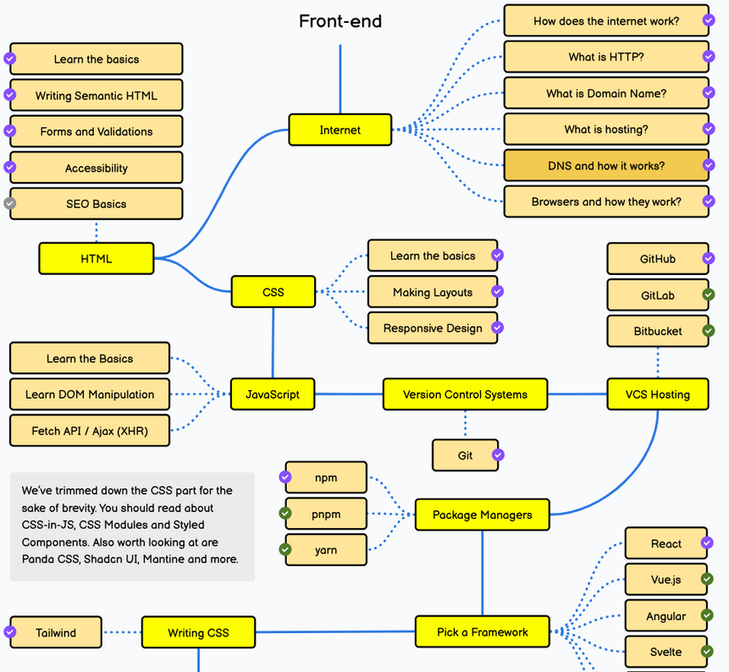
FRONTEND ROADMAP
Detailed Frontend Roadmap can be found in :
Frontend Roadmap

Slide 24
THANK YOU
Any Queries ?
Resources :
Email Queries at:
Github Repo
erlujashakya@gmail.com
nirjalprajapati@gmail.com

